Slide 1
Non Uniform Sampling Aggregator-Encoder GCN
By Rahul, Shantanu and Tarun

Slide 2
Graph Embeddings
Graphs, such as social networks, word co-occurrence networks, and communication networks, occur naturally in various real-world applications.
Why node embedding ?
Use dimensionality reduction techniques to distill the high-dimensional information about a node’s graph neighborhood into a dense vector embedding
The two major applications of graph analysis are :
Predicting the links between different nodes of a graph.
Classification of nodes based on other labeled nodes and graph topology.
Notes:
Use diagram to explain.

Slide 3
Motivation
Most existing approaches require all nodes in the graph to be present during training of the embeddings
Lack of general inductive frameworks that leverage node feature information to efficiently generate node embeddings for previously unseen data
Low classification accuracy of random walk approaches
Cora dataset
Random walks : 0.206
Features : 0.575
Deepwalk : 0.701
Notes:
DeepWalk preserves higher-order proximity between nodes by maximizing the probability of observing the last k nodes and the next k nodes in the random walk centered at a vertex v_i. Does not scale for large graphs.
Node2vec employs biased-random walks that provide a trade-off between breadth-first (BFS) and depth-first (DFS) graph searches, and hence produces higher-quality and more informative embeddings than DeepWalk.

Slide 4
Objectives
Supervised Node Classification model for small graphs and that which scales to large graphs with millions of edges.
Learn from both graph structure and node attributes, to support attributed graphs.
Support across­ network transfer learning
Notes:
Switch to RAHUL
Task of generalizing across graphs, which requires learning about node roles rather than community structure .. Especially for PPI dataset

Slide 5


Graph Convolution Network by Kipf & Welling, ICLR 2016
Localized first-order approximation of spectral graph convolutions
Layerwise convolution rule
H : activation matrix in layer l
W : layer specific trainable weight matrix

Slide 6

GCN
2 layer GCN
Minimize cross entropy loss
Limitations
Gradient descent on full dataset for each iteration
Useful only for very small graphs
Transductive

Slide 7
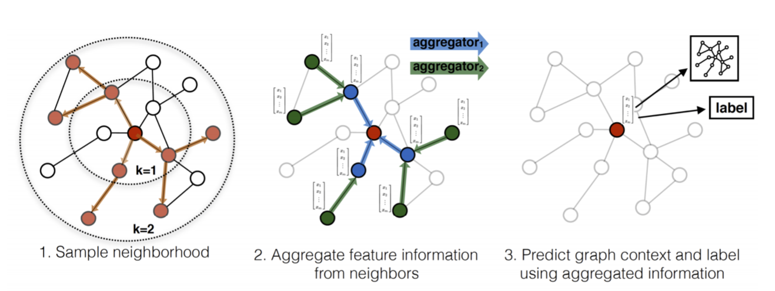
Aggregator Encoder Model
An inductive approach to generating node embeddings
Train a set of aggregator functions that learn to aggregate feature information from a node’s local neighborhood

Slide 8
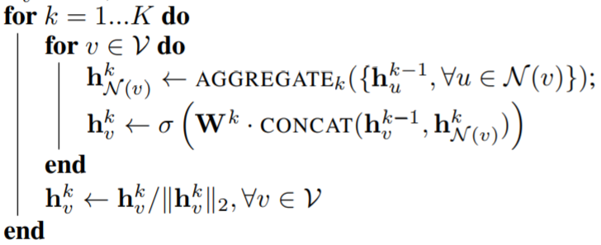
Algorithm
“GraphSage : Inductive Representation Learning on Large Graphs -W L Hamilton 2017”

Slide 9
Graphsage Limitations
Limitations
Random sampling
Low classification accuracy for small to medium sized graphs

Slide 10
Model Aggregator GCN
Our Approach in a nutshell
Use graphsage inductive learning approach
Mean aggregator
Non uniform sampling of neighbours across each layers
Restricted neighbourhood size
Notes:
Switch to shantanu

Slide 11

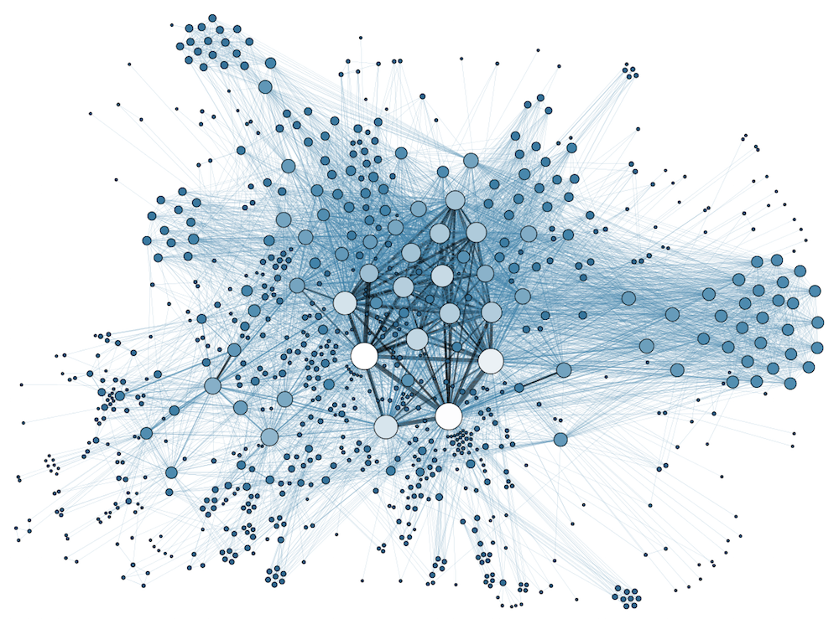
CNN
CNN Block
Convolution
non-linearity
Pooling
cat
tiger
duck
GCN
GCN Block
Aggregation
non-linearity
Embedding
Generation
Neural_Networks
Rule_Learning
Reinforcement_Learning

Slide 12
Sampling
Major sampling techniques used:
Random Sampling
Priority Sampling
Hybrid Sampling
Mixed Sampling: Combinations of these sampling techniques across each layer of neural network

Slide 13
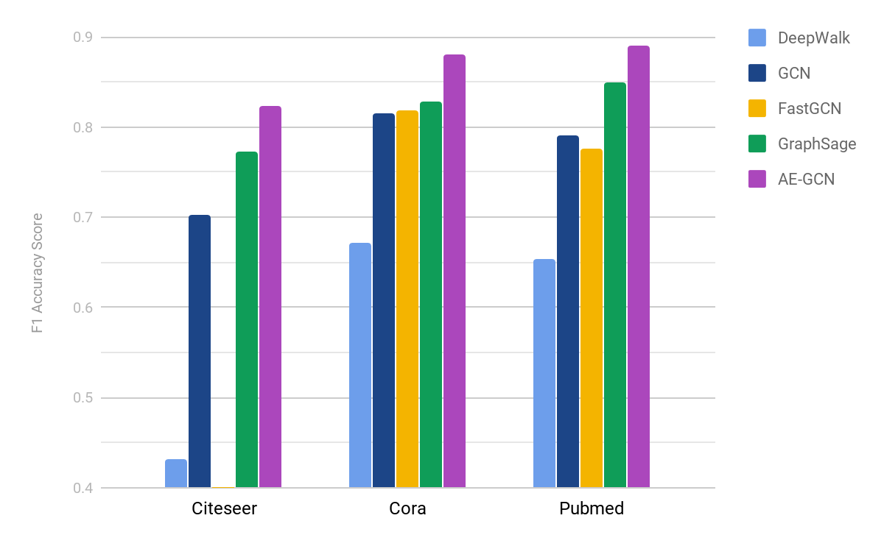
Comparing Prediction Accuracy
 | Cora | Citeseer | Pubmed
GCN | 81.5 | 70.3 | 79.0
FastGCN | 81.8 |  | 77.6
GraphSage | 82.9 | 77.2 | 84.9
DeepWalk | 67.2 | 43.2 | 65.3
AE-GCN | 88.1 | 82.3 | 89.1
Notes:
1 classifying academic papers into different subjects using the Web of Science citation dataset
2 classifying Reddit posts as belonging to different communities
3 classifying protein functions across various biological protein-protein interaction (PPI) graphs
Cora (2708, 5429, 7, 1433)
Citeseet (3312, nil, 6, 3703)
Pubmed (19717, 44338, 3, 500)

Slide 14
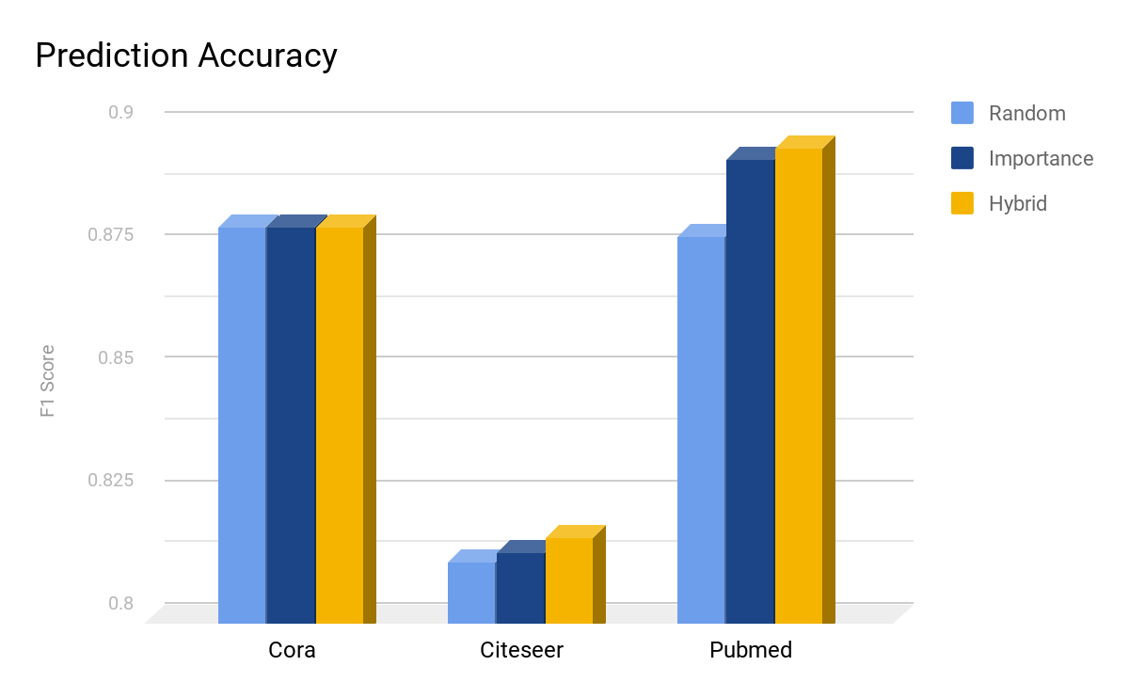
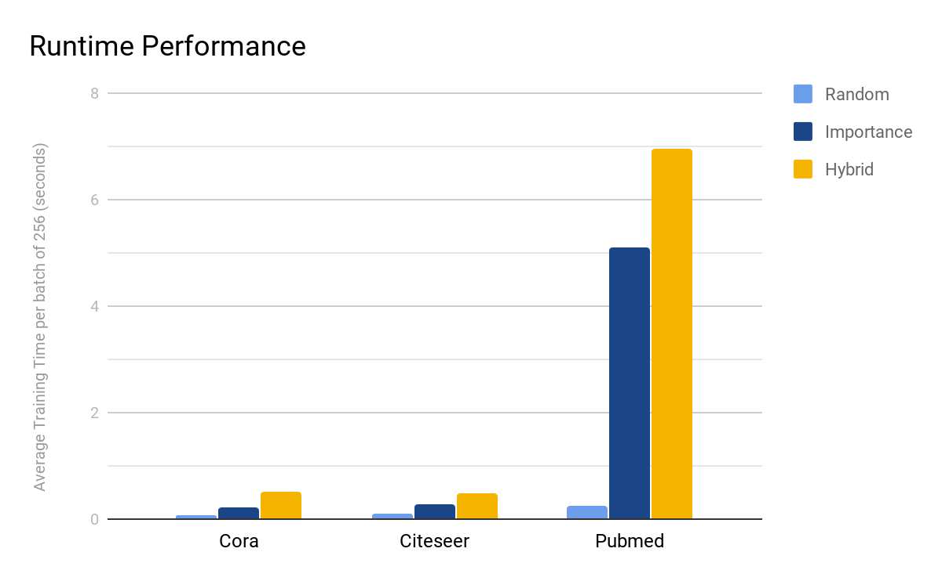
Sampling
Choosing the right sampling technique for capturing the most representative nodes in the local neighborhood

Slide 15
Model Aggregator GCN
Our Approach in a nutshell
Use graphsage inductive learning approach
Mean aggregator
Non uniform sampling of neighbours across each layers
Restricted neighbourhood size
Notes:
Switch to shantanu

Slide 16
Conclusion
Future directions
Experiments with multi-graph datasets to test transfer learning
Negative sampling to increase embedding quality
Deep layered network
Alternative aggregators like LSTM and Max-Pooling

Slide 17
Questions?

